Slide 1
Dataset &
Preprocessing
Feature validation through molecular descriptor analysis
Notes:
This is the section divider for Section 2. Transition from the previous section and introduce the two main topics: how we built the dataset, and the preprocessing decisions we made before running models in Jad Bio.

Slide 2
2.1 Dataset Overview
Source
138
floral
fruity
GoodScents + Leffingwell PMP 2001
descriptors
sweet
woody
▼
4,983
138
Semantic clustering
green
spicy
molecules
odor descriptors
▼
animal
musk
earthy
12
Labels assigned by trained perfumers & flavor chemists
metacategories
citrus
chemical
gourmand
powdery
amber
Notes:
The dataset comes from two of the most widely used publicly available databases in olfactory research: GoodScents and the Leffingwell PMP 2001 compendium. Both contain odor descriptors assigned by trained perfumers and flavor chemists — so these are high-quality, expert-curated labels. Together they give us 4,983 molecules. The challenge is that the original label space is enormous: 138 different odor descriptors. This creates a two-part problem that we'll address on the next slide.

Slide 3
Why Reduce to 12 Labels?
PROBLEM
ATTEMPT
SOLUTION
Data is multi-label Each molecule carries multiple odor descriptors simultaneously Jad Bio only handles uni- label classification
One binary classifier per descriptor (one-vs-rest) 138 classifiers
Too much to train 138 models only for validation purposes
Cluster 138 → 12 metacategories 12 binary classifiers Each label has more positive examples → less sparsity as a bonus
→
→
solution
Notes:
The first problem is that our data is multi-label — each molecule can have multiple odor descriptors assigned simultaneously. Jad Bio doesn't support multi-label classification natively, so we convert to binary classifiers. The obvious solution is to train one binary classifier per descriptor — one-vs-rest — but that means 138 models, which is completely impractical for this validation phase. The solution is to cluster the 138 descriptors into 12 semantically coherent metacategories using a lookup table established by a previous student and shared by our tutor. This reduces the problem to just 12 binary classifiers — one per metacategory — which is manageable. A bonus: each label now has significantly more positive examples, which also reduces sparsity.

Slide 4
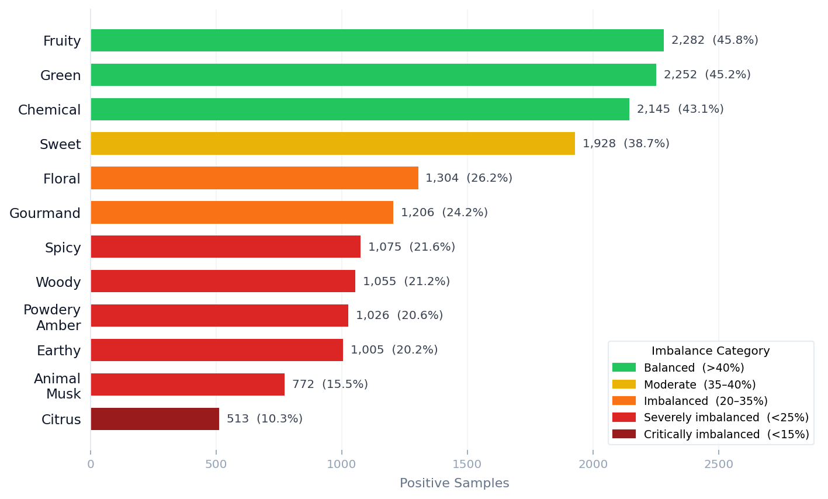
2.2 Label Distribution & Imbalance
Notes:
Here's the distribution of positive samples across our 12 metacategories. There's a very wide range: Fruity has 2,282 positive samples — 45.8% of the dataset — while Citrus has only 513 at 10.3%. I've color-coded them by imbalance level. The top three labels — Fruity, Green, and Chemical — are relatively balanced at 43 to 46%. As we go down the list, the imbalance becomes progressively more severe. This has direct consequences for model training, which we'll see shortly. Importantly, for the balanced labels we did not apply SMOTE — only imbalanced labels required intervention.

Slide 5
The Imbalance Problem : Animal Musk Example
Animal Musk: 772 positive out of 4,981 total only 15.5% of the dataset Severely imbalanced
87.9%
35.4%
66.5%
47.2%
Accuracy
True Positive Rate
Balanced Accuracy
F1 Score
Looks good…
65% of musks are missed!
Reveals the real picture
Poor minority performance
Why this matters beyond bad metrics
The model learns to predict not Animal Musk most of the time which is correct 84.5% of the time by default. Feature selection becomes corrupted: selected features characterize the majority class, not Animal Musk chemistry.
This is not just a performance problem , it is a fundamental validity problem.
Notes:
Let's look at what happens concretely when we train on an imbalanced label. Animal Musk has 772 positive samples out of 4,981 — just 15.5% of the dataset. When we train directly without balancing, we get an accuracy of 87.9% — which looks acceptable at first glance. But the True Positive Rate is only 35.4%. The model is missing 65% of actual Animal Musk molecules. It has simply learned to say 'not Animal Musk' most of the time, which is correct 84.5% of the time by default. But the real problem goes beyond bad metrics: the feature selection becomes corrupted. The features being selected are those that best identify non-musk molecules — not those that characterize Animal Musk chemistry. This is a fundamental validity problem, not just a performance issue. This is the core motivation for SMOTE.

Slide 6
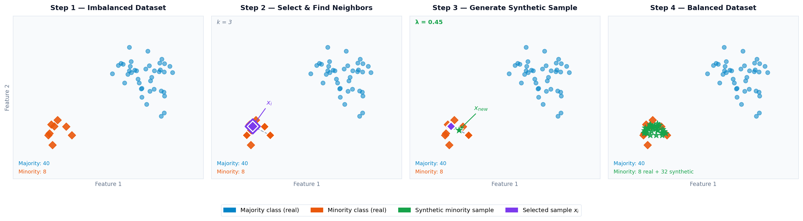
SMOTE : Synthetic Minority Over-sampling Technique
x_new = x_i + λ · ( x_nn − x_i )
where λ ∈ [0, 1]
Interpolates in feature space
Does not invent new chemistry
Notes:
To address class imbalance, we use SMOTE — Synthetic Minority Over-sampling Technique. The key idea is to generate synthetic minority class samples by interpolating between existing minority samples in feature space — not in chemical space. Step 1: we start with our imbalanced dataset. Step 2: for each minority sample x_i, we identify its k nearest neighbors among the other minority samples. Step 3: we generate a new synthetic sample by picking a random point along the line connecting x_i to one of its neighbors x_nn. The formula is: x_new equals x_i plus lambda times open parenthesis x_nn minus x_i close parenthesis, where lambda is drawn uniformly from 0 to 1. Step 4: we repeat this until the classes are balanced. The crucial point: SMOTE operates in feature descriptor space. It does not create new molecular structures. It interpolates between molecular descriptor vectors of real molecules. This distinction is central to the validity of our approach.

Slide 7
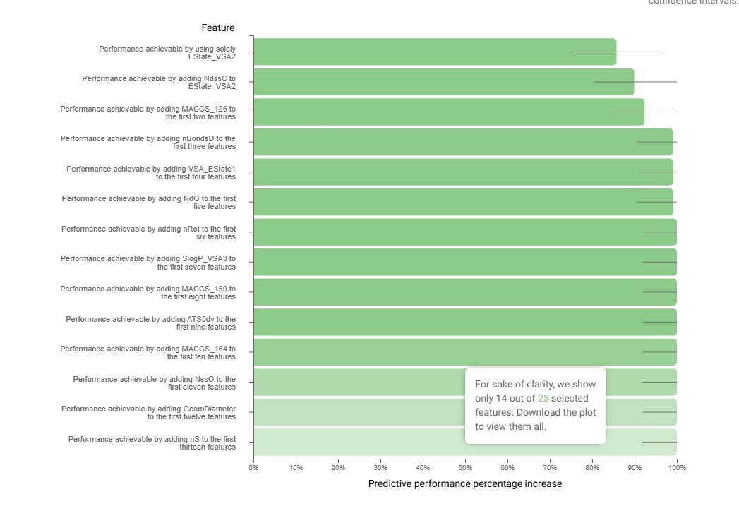
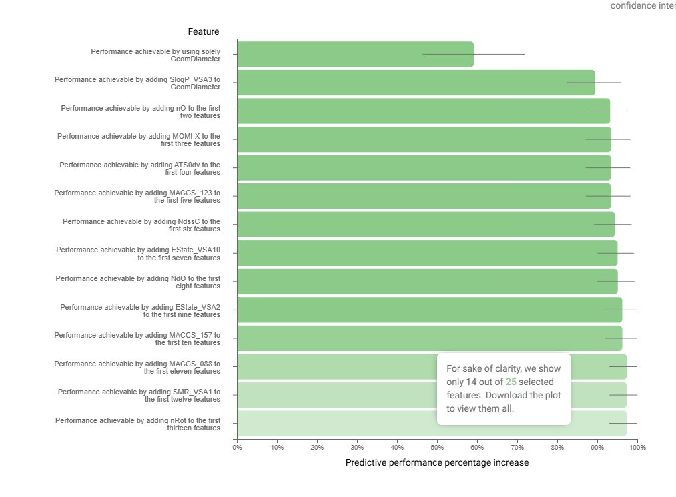
Feature Selection: Before vs After SMOTE (Animal Musk)
BEFORE SMOTE — Imbalanced
AFTER SMOTE — Balanced
First feature alone (EState_VSA2): 85.7% Model is exploiting majority class and not learning musk chemistry
First feature (GeomDiameter): 59 % gradual build-up Model is actually learning Animal Musk chemistry
Notes:
This is the key evidence for why SMOTE is necessary for imbalanced labels. On the left, before balancing: the very first feature EState_VSA2 alone already achieves around 85% performance. This is a red flag — no single feature should dominate that much for a genuinely complex olfactory label. What's happening is the model is using EState_VSA2 to identify non-Animal-Musk molecules very efficiently, because that's what the majority class looks like. Then performance quickly plateaus — almost no new information is added by subsequent features. On the right, after SMOTE: the first feature GeomDiameter starts at only about 60%, and performance builds gradually and more meaningfully as features are added. This is the expected behavior when a model is genuinely learning the chemistry of the positive class. The feature set also changes substantially — different features emerge as important when the model can no longer cheat by predicting the majority class.

Slide 8
Why Feature Selection After SMOTE Is Valid
1
Statistical Prior Correction
SMOTE corrects the class probability imbalance in the training distribution. It does not generate new chemical patterns , it rebalances the weight the classifier assigns to each class during training. All chemical information comes entirely from real molecules.
2
Train / Test Separation
SMOTE was applied only to the training split. The test set contains exclusively real molecules. This preserves the integrity of generalization. Jad Bio's evaluation metrics are discarded (computed on SMOTE-augmented data), but this does not affect the validity of feature selection.
3
Feature Selection Is Grounded in Real Data
The features selected after balancing are those that genuinely characterize the minority class in the real molecules. Synthetic samples do not introduce new chemical information , they simply ensure the classifier pays equal attention to both classes, preventing the corruption we saw in the imbalanced case.
Notes:
So why can we trust the feature selection from SMOTE-balanced data, even though some training samples are synthetic? The argument has three pillars. First, SMOTE is a statistical prior correction tool. It doesn't create new chemical patterns — it rebalances the probability distribution so the classifier pays equal attention to both classes. All the chemistry comes from real molecules. Second, we applied SMOTE only to the training split. The test set contains only real molecules. This is why we discard Jad Bio's evaluation metrics — they were computed on a partition that includes synthetic samples — but it does not invalidate the feature selection. Third, and most importantly: after balancing, the features selected are those that genuinely characterize Animal Musk chemistry in the real minority samples. The synthetic samples don't introduce new information — they just ensure the minority class signal isn't drowned out during training. The bottom line: discard the metrics, keep the features — that's our position, and it is methodologically sound.

